Slide 1
In-class Exercise 16 - Split
Dhiren Gupta
-800902466

Slide 2

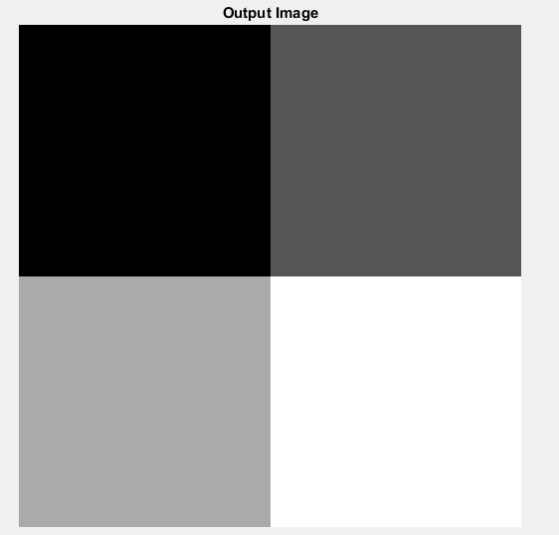
Quad: Input Image vs Output Image

Slide 3

Quad: Input Image vs Visualize_sp Output Image

Slide 4
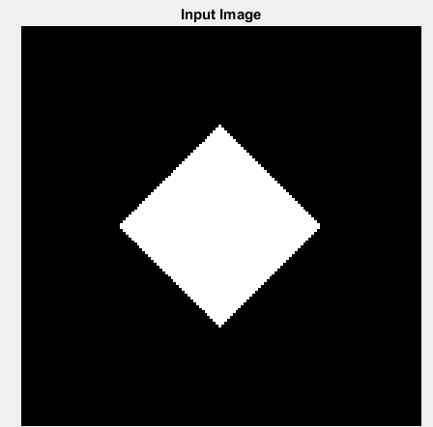
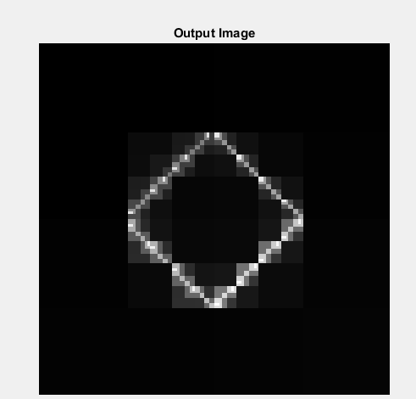
Diamond: Input Image vs Output Image

Slide 5

Diamond: Input Image vs Visualize_sp Output Image

Slide 6

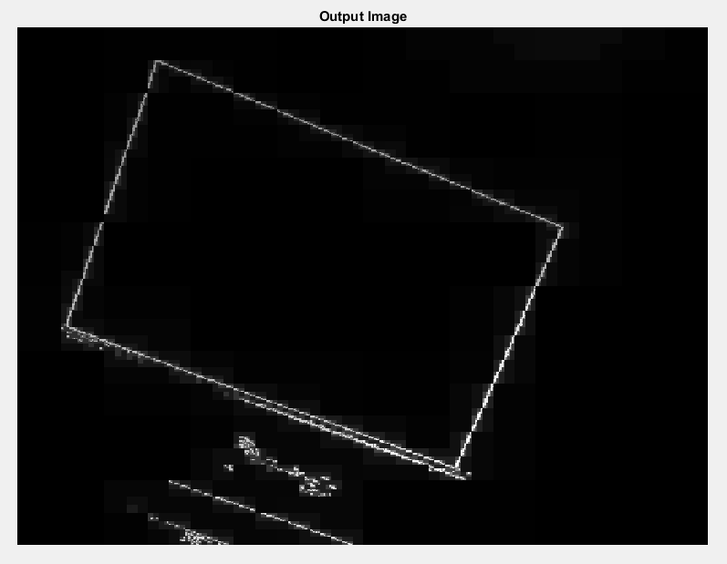
Input –T=10: Input Image vs Output Image

Slide 7

Input –T=10 : Input Image vs Visualize_sp Output Image

Slide 8
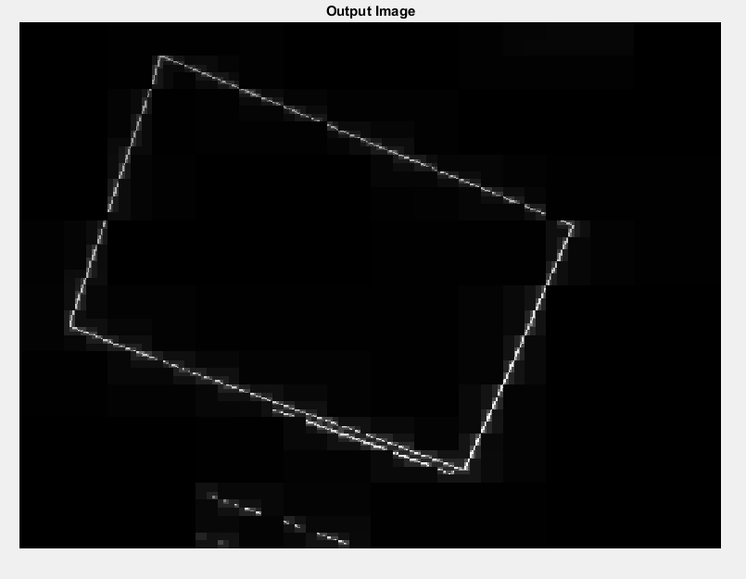
Input –T=20: Input Image vs Output Image

Slide 9

Input –T=20 : Input Image vs Visualize_sp Output Image

Slide 10
Thank You

